Slide 1

Demand Forecasting for E-Commerce Products using Machine Learning

Slide 2

Introduction
In the ever-evolving landscape of E-commerce, staying ahead of consumer demands is not merely a strategy but a necessity. The ability to forecast product demand accurately is the linchpin that defines success in this dynamic realm.
Traditional forecasting methods often fall short in capturing the nuances of rapidly changing consumer behaviors. This research project delves into the transformative potential of Machine Learning (ML) for demand forecasting in E-commerce.
By combining the power of data-driven insights with state-of-the-art algorithms, this project endeavors to revolutionize the way E-commerce enterprises approach inventory management, ultimately enhancing customer satisfaction and operational efficiency.
Future of E-Commerce: “Where intelligence meets demand, and innovation defines success.”

Slide 3
Literature Review
1. Evolution of Demand Forecasting
2. Traditional Demand Forecasting Methods
3. Limitations of Traditional Methods in E-commerce
4. Machine Learning in Demand Forecasting
5. Applications of Machine Learning in E-commerce
6. Challenges in E-commerce Demand Forecasting: Dynamic Consumer Behaviour, Short product life cycles, High Product Diversity, Influence of External Factors, Data Quality and Integration
7. Opportunities in E-commerce Demand Forecasting: Real Time Data processing, Personalization and Customer Segmentation, Continuous Learning and Adaptability, Improved Inventory Management, and Enhanced Decision-Making.

Slide 4
Problem Statement
In the fast-paced landscape of E-commerce, the traditional methodologies employed for demand forecasting are proving inadequate in navigating the complexities of dynamic consumer behaviors, rapid market changes, and the influx of diverse product offerings. As online retail continues to surge, the demand for precise and adaptive forecasting models becomes imperative for sustaining operational efficiency and customer satisfaction. The existing literature reveals a critical gap in the application of Machine Learning (ML) techniques, specifically ensemble methods like Random Forests, to address the unique challenges posed by E-commerce demand forecasting. This research project seeks to bridge this gap by investigating the efficacy of ML-driven ensemble methods in accurately predicting product demand, thus contributing a transformative lens to the evolving narrative of E-commerce analytics.

Slide 5
Aims and Objectives
The main aim of this research is to develop accurate and effective demand forecasting models using machine learning techniques for e-commerce products, enabling businesses to optimize inventory management and enhance operational efficiency.
Investigate the effect of different product categories and sub-categories on pricing and discounts.
Investigate the relationship between pricing strategies and the likelihood of a product being sold.
Utilize Machine Learning techniques to develop a predictive model for estimating product demand and sales based on the provided attributes.
Evaluate and compare the performance of different machine learning algorithms, such as regression models, and neural networks, in predicting demand for ecommerce products.

Slide 6
Methodology
Collected dataset from Kaggle “Amazon Products Dataset 2023”
Exploratory Data Analysis has been done on the data to understand it.
Handled Outliers, imputed the null values, created new columns.
Data visualization has been done in order to understand the data visually.
Feature Selection has been done by using Principal Component Analysis.
Ensemble Techniques have been applied on the dataset such as Linear Regression, Decision Tree Regressor, Random Forest Regressor, XGBoost, LSTM, and FNN.
Dataset has been split in to two parts. Train data and Test data in the ratio 70:30
Model Evaluation is done using the metrics named R2-Score, MSE, RMSE, and MAE.

Slide 7
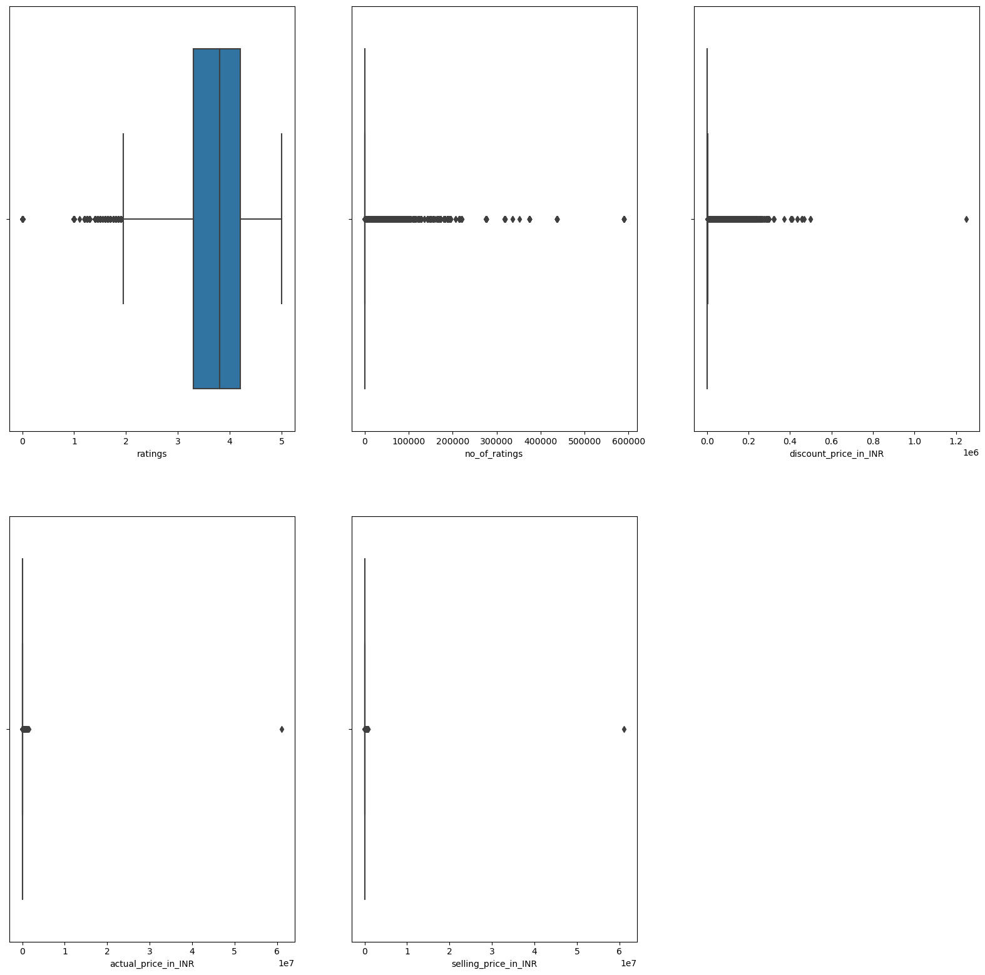
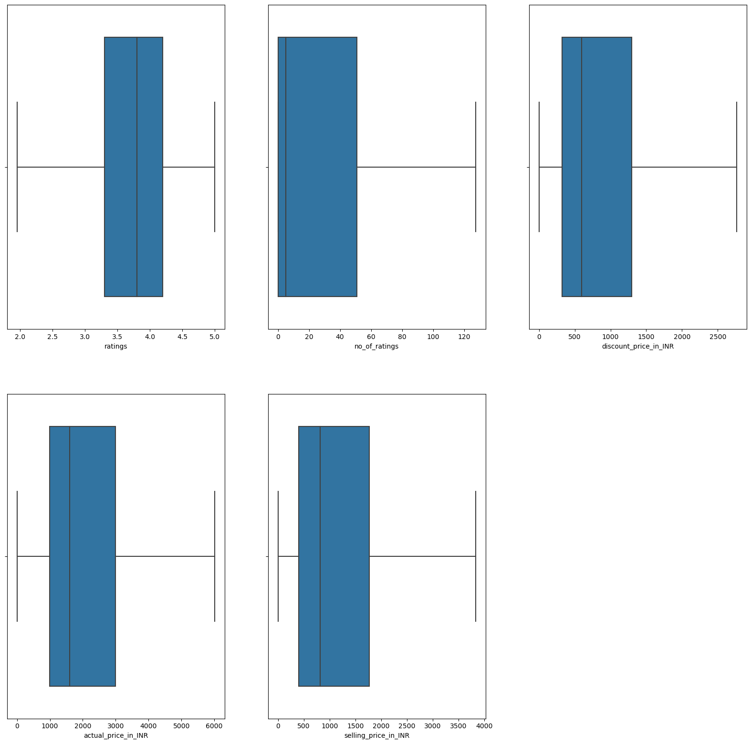
Data Visualization
Box Plot with outliers
Box Plot without outliers

Slide 8
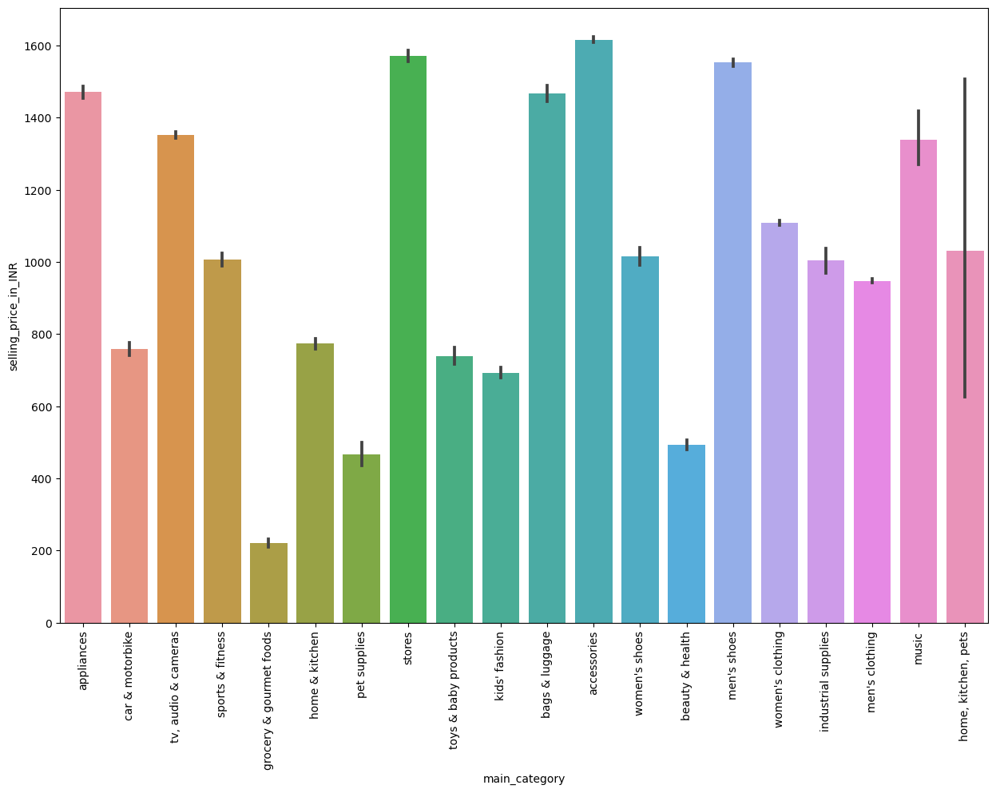
Main Category vs Selling Price

Slide 9
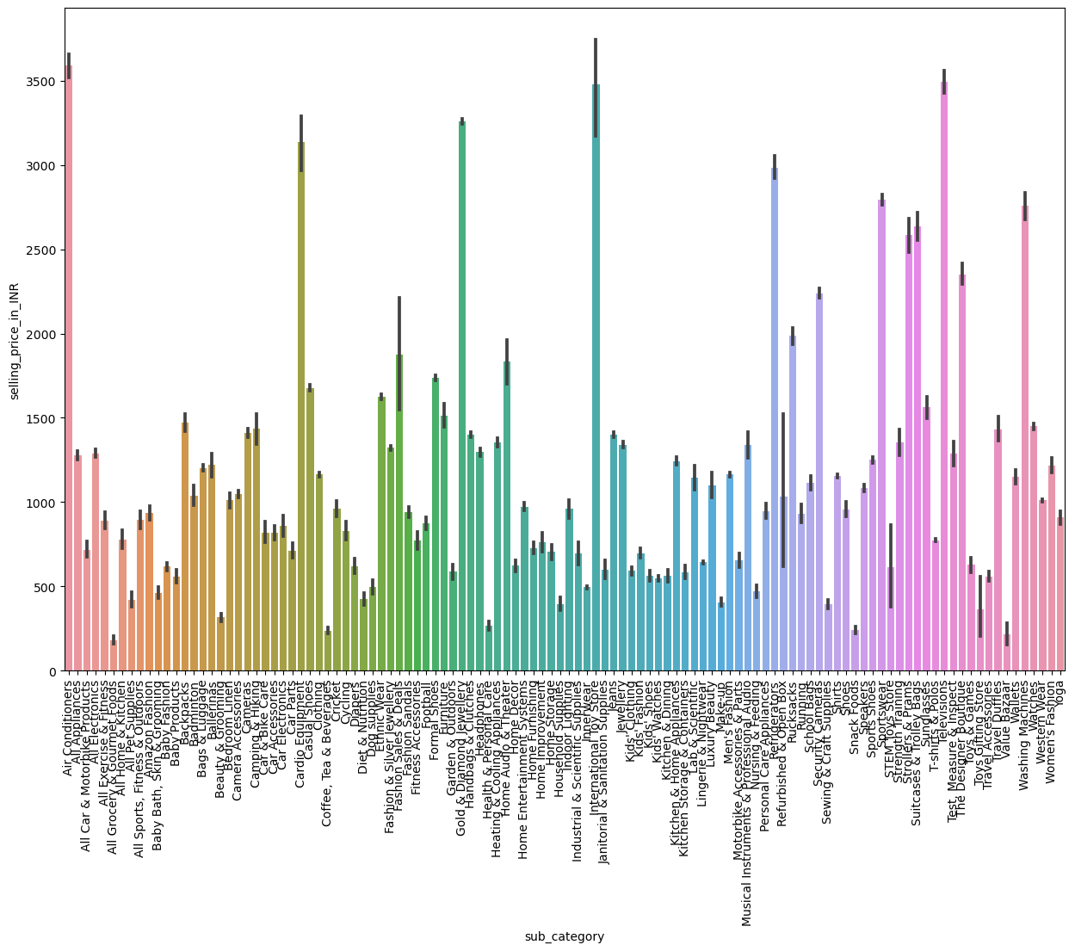
Air Conditioners, Televisions, International Toy Store, Gold & Diamond Jewellery, and Cardio Equipments are the top five sub categories in terms of selling price.

Slide 10
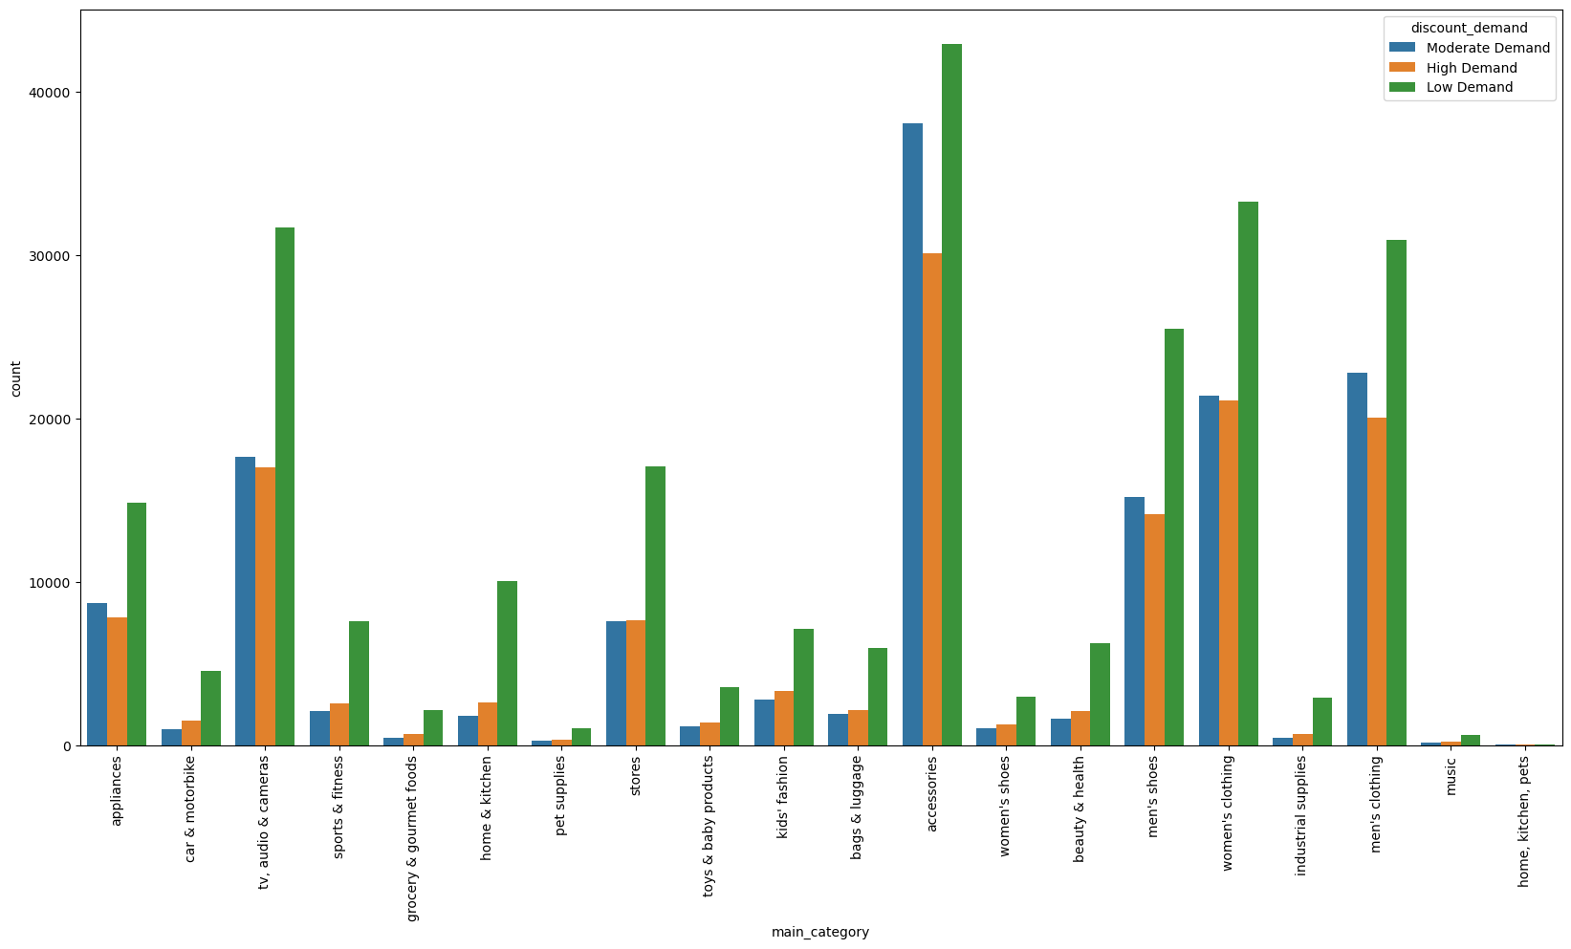
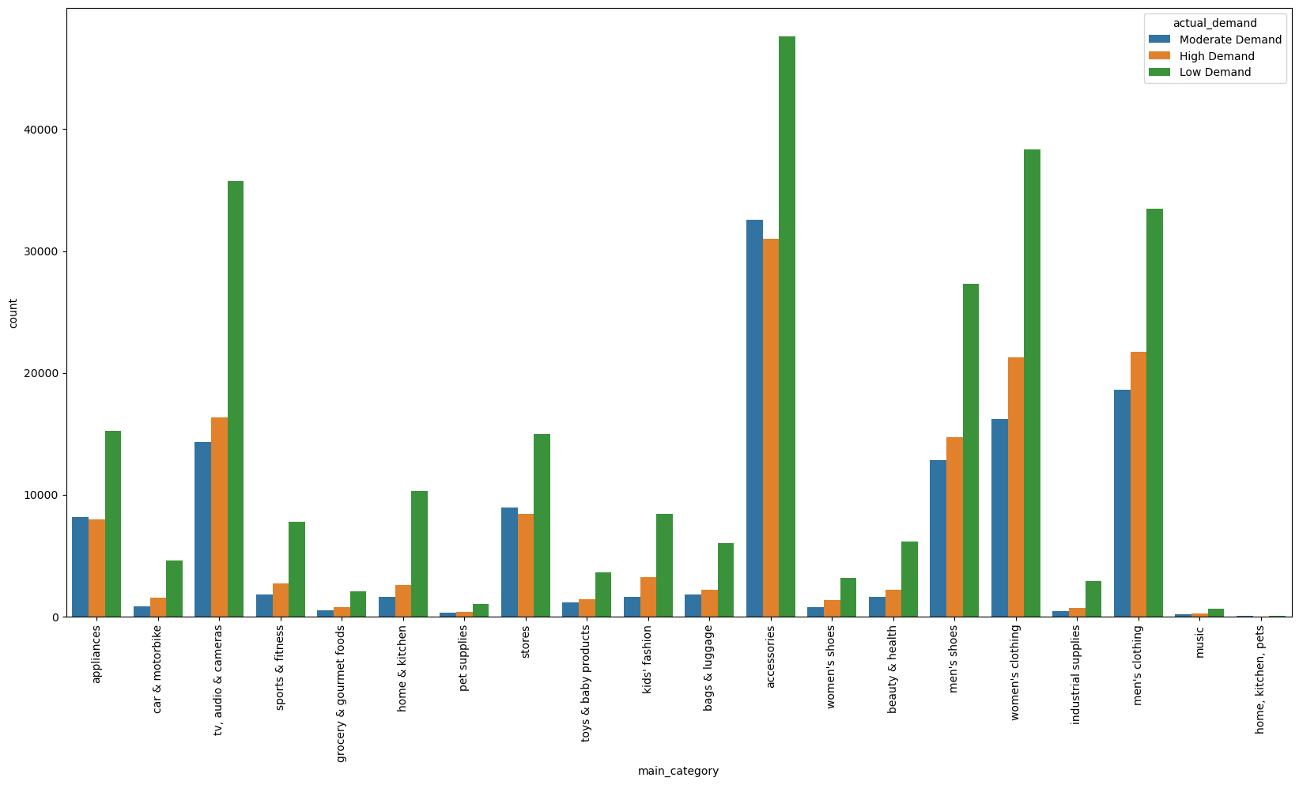
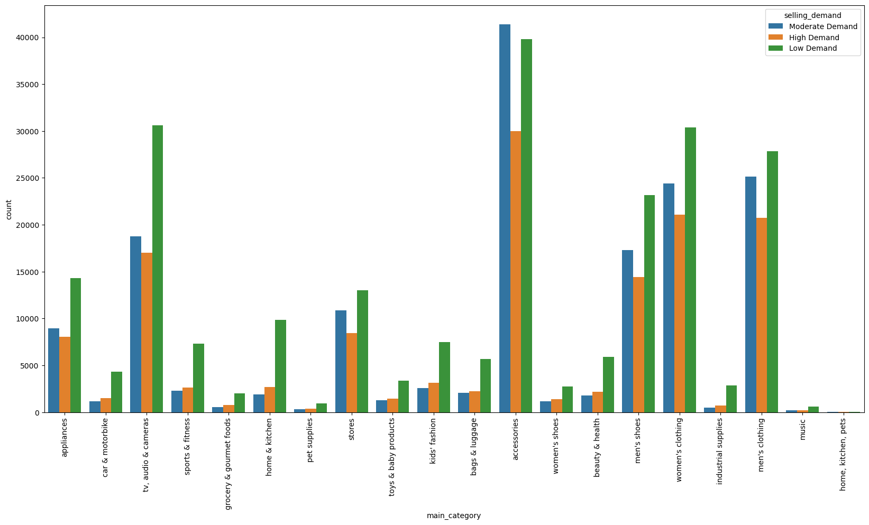

Slide 11
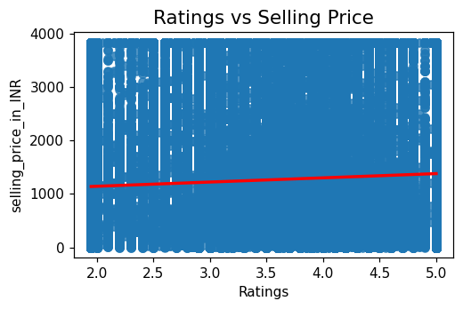
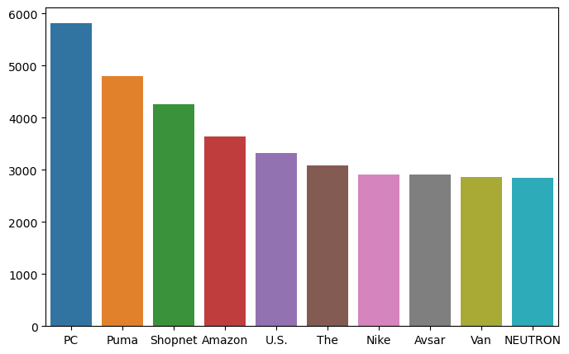
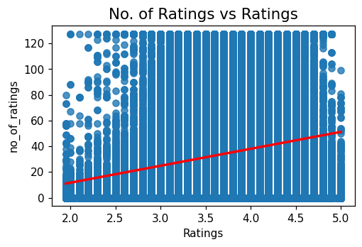
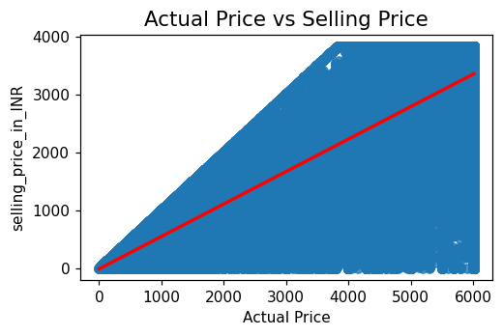
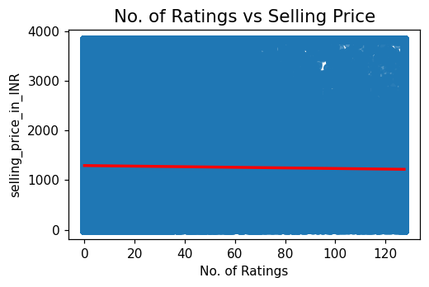
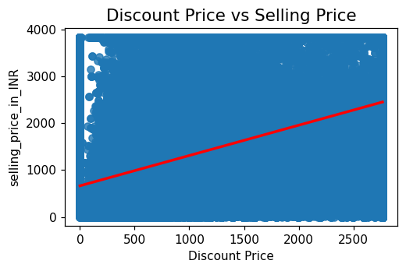

Slide 12
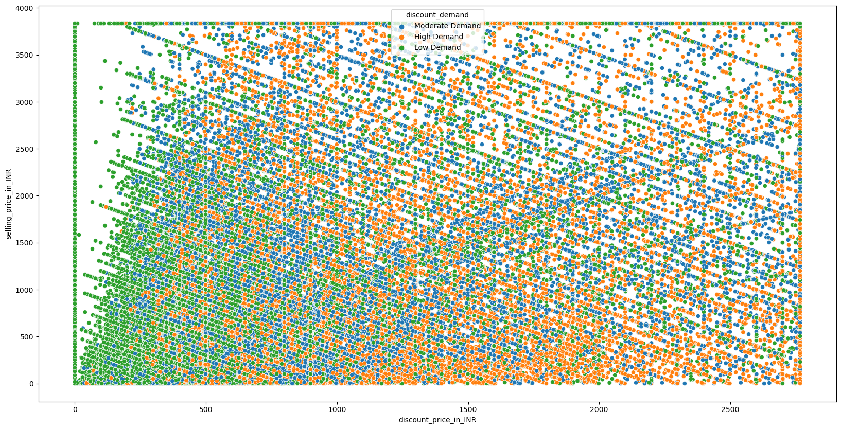
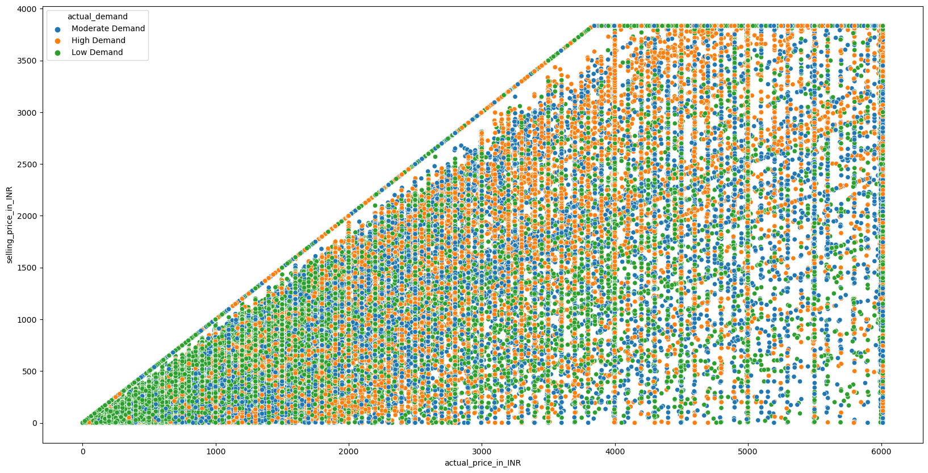

Slide 13
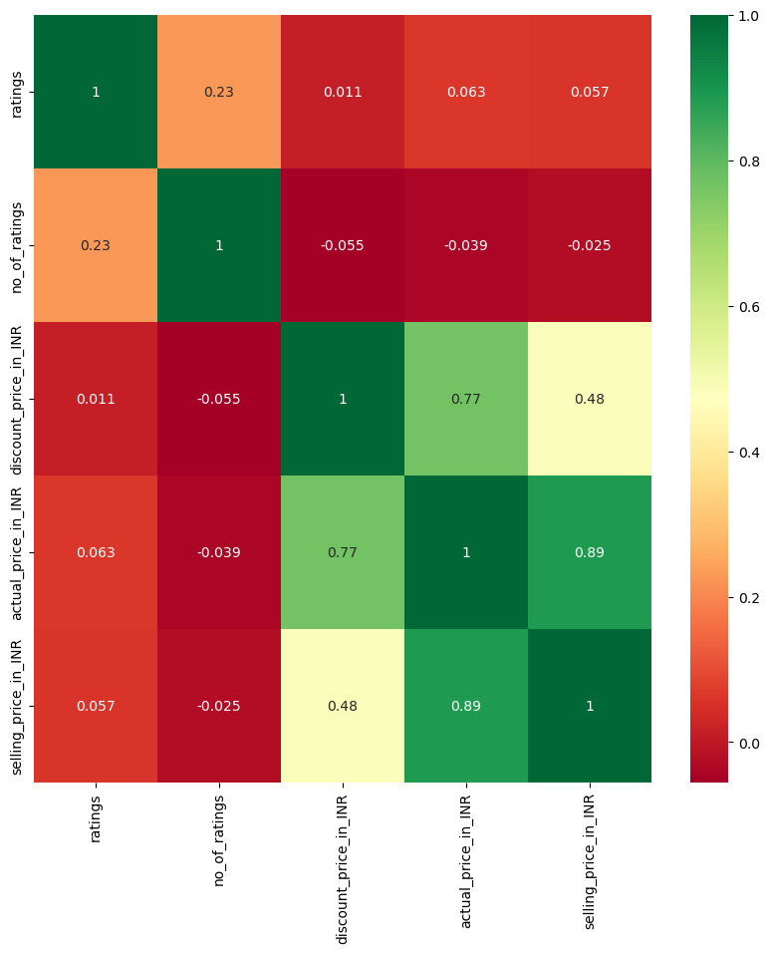
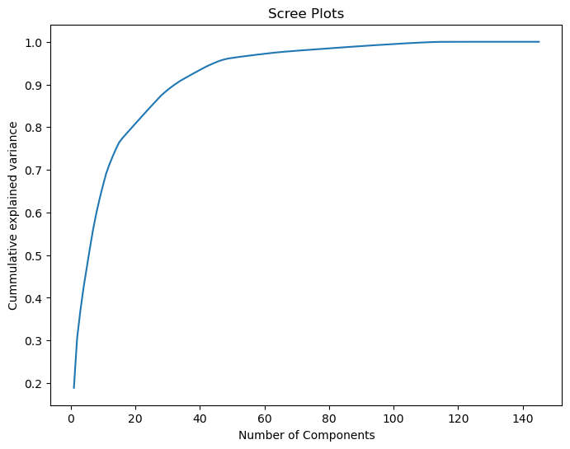

Slide 14
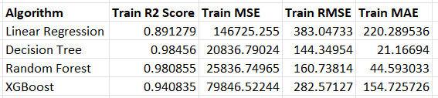
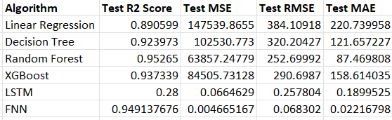
Results and Discussions
Results captured for train dataset
Results captured for test dataset

Slide 15
Conclusions
Random Forest outperformed the LSTM, FNN. If we compare only the ML algorithms, then Random Forest scored the best r2_score. If we compare the neural networks, FNN outperformed the LSTM. If we check the MSE, RMSE then FNN has the minimized values and highest r2_score. For train dataset, Decision Trees outperformed all the other applied algorithms.
Future Recommendations
For future advancements, integrating image recognition into the dataset holds great potential. This approach can enhance product identification and contribute to more accurate price predictions. Leveraging convolutional neural networks (CNNs) or similar techniques to extract visual features promises to capture nuanced patterns, offering a holistic perspective for improved machine learning models in E-commerce demand forecasting. Exploring the inclusion of visual data can lead to more comprehensive and sophisticated predictive analytics.

Slide 16
THANK YOU

